Slide 1

Maven, Eclipse and OSGi working together
Carlos Sanchez
March 17, 2008

Slide 2
About me
Member of Apache Maven PMC
Committer at the Eclipse Foundation
Director at Exist Global

Slide 3
Contents
Maven in the Eclipse IDE
Maven to OSGi
Eclipse plugins to Maven
Maven building Eclipse plugins
Looking into the future
Conclusions

Slide 4
Section 1
Maven in the Eclipse IDE

Slide 5
Maven in the IDE
Q4E
[Q for Eclipse]
Proposed to the Eclipse Foundation as
Eclipse IAM
[Eclipse Integration for Apache Maven]

Slide 6
Maven in the IDE
Other alternatives
m2eclipse
Maven Eclipse plugin
[eclipse:eclipse]

Slide 7
Q4E Features
running Maven goals from the IDE
dependency managing using the POM
& automatic download of dependencies
Eclipse classpath synchronized with POM

Slide 8
Q4E Features
direct import of Maven 2 projects
wizard for creation of new projects using the archetype mechanism

Slide 9
Q4E Features
modular approach to improve reusability by other Eclipse projects
ability to import parent projects (pom projects)‏
ability to cancel Maven builds

Slide 10
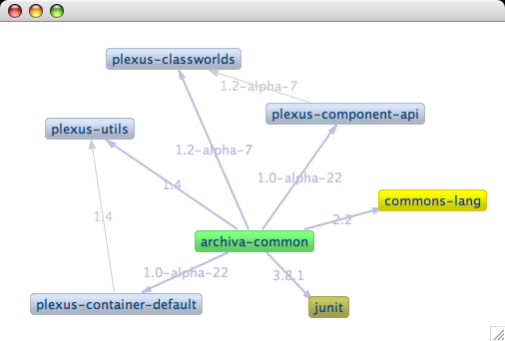
Q4E dependency graphing

Slide 11
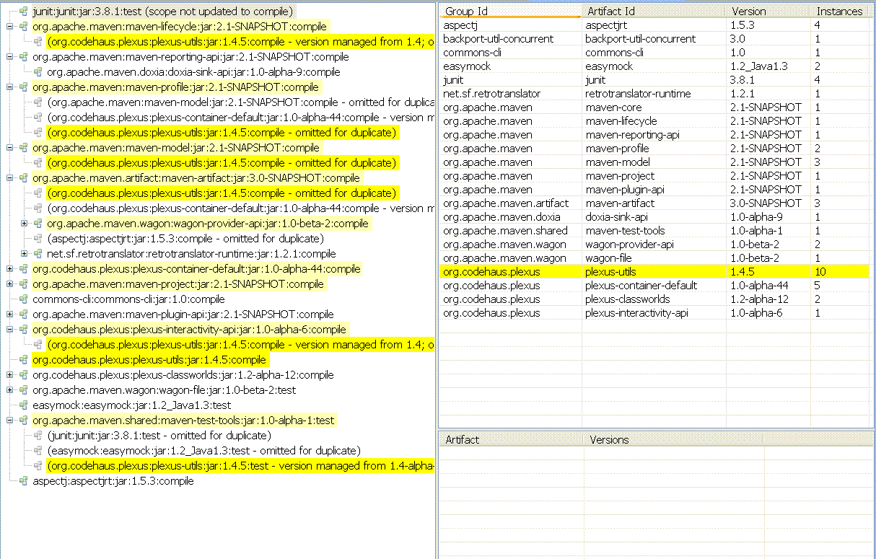
Q4E dependency analysis

Slide 12
Roadmap
WTP support
Integration with other plugins
Scala, Candy for Appfuse, SpringIDE,...
UI tooling to work around Maven limitations (common complains)‏
Excluding a dependency from the graphs will add all necessary <exclusions> to the pom

Slide 13
Q4E as example
All examples in next sections are
real-world examples
from Q4E development
https://q4e.googlecode.com/svn/branches/mavenbuild

Slide 14
Section 2
Maven to OSGi

Slide 15
Tools
Bleeding edge!!!
Apache Maven 2.0.9+
(includes bug fixes MNG-3396 and MNG-3410)‏
Apache Felix Bundle Plugin 1.4.1+
Maven PDE plugin 1.0+
Maven Eclipse plugin 2.5+

Slide 16
Converting 3rd party Maven projects to OSGi
Create a new Maven project
Set <packaging> to bundle
Add maven-bundle-plugin
Add dependencies to the 3rd party projects

Slide 17
Felix Maven Bundle plugin
Maven philosophy: will use defaults for most of the configuration
Manifest still completely customizable
http://felix.apache.org/site/maven-bundle-plugin-bnd.html

Slide 18
Felix Maven Bundle plugin
will scan your classes for exported/imported packages
will not use Require-Bundle

Slide 19
Felix Maven Bundle plugin
By default ${groupId}.${artifactId} packages get included, use Export-Packages to customize
Export-Packages exports AND includes the classes in the bundle
<_exportcontents> only exports

Slide 20
Felix Maven Bundle plugin
inline=true to avoid embedding jars inside the bundle
Needs to run after compilation

Slide 21
Converting 3rd party Maven projects to OSGi
<packaging>bundle</packaging>
[...]
<build>
<plugins>
<plugin>
<groupId>org.apache.felix</groupId>
<artifactId>maven-bundle-plugin</artifactId>
<!-- <version>1.4.0</version> defined in parent plugin management -->
<extensions>true</extensions>
<configuration>
<instructions>
<Embed-Dependency>*;scope=compile|runtime;inline=true</Embed-Dependency>
<Embed-Transitive>false</Embed-Transitive>
</instructions>
</configuration>
</plugin>
</plugins>

Slide 22
Converting 3rd party Maven projects to OSGi
Example
plugins/thirdparty/org.apache.maven.shared.dependency.tree
repackages
<dependency>
<groupId>org.apache.maven.shared</groupId>
<artifactId>maven-dependency-tree</artifactId>
<version>1.1</version>
</dependency>
as OSGi bundle

Slide 23
Dependency handling
Customize the dependencies included
by using
<exclusions>
<_exportcontents>
<Export-Package>
<Embed-Dependency>
<Embed-Transitive>

Slide 24
Dependency handling
Customize the dependencies imported and the versions
by using
Import-Package

Slide 25
Dependency handling: example
plugins/maven/embedder/pom.xml
Includes all dependencies in a lib folder inside the bundle
Some dependencies are exchanged for prebuild OSGi bundles and depended upon
Exports a few org.apache.maven and
org.codehaus.plexus packages only

Slide 26
Example
<dependency>
<groupId>org.apache.maven</groupId>
<artifactId>maven-embedder</artifactId>
<version>2.1-SNAPSHOT</version>
<exclusions>
<!-- we'll use eclipse bundles for these -->
<exclusion>
<groupId>com.jcraft</groupId>
<artifactId>jsch</artifactId>
</exclusion>
<exclusion>
<groupId>aspectj</groupId>
<artifactId>aspectjrt</artifactId>
</exclusion>
[...]
</exclusions>
</dependency>
[...]
<!-- Eclipse bundles dependencies -->
<dependency>
<groupId>org.aspectj</groupId>
<artifactId>runtime</artifactId>
</dependency>
<dependency>
<groupId>com.jcraft</groupId>
<artifactId>jsch</artifactId>
</dependency>

Slide 27
Example: Bundle plugin config
<plugin>
<groupId>org.apache.felix</groupId>
<artifactId>maven-bundle-plugin</artifactId>
<configuration>
<instructions>
<_exportcontents>
org.apache.maven.embedder.*;-noimport:=true,
org.apache.maven.*;-noimport:=true,
org.codehaus.plexus.util.xml.*;-noimport:=true,
!org.codehaus.plexus.util.*,
org.codehaus.plexus.*;-noimport:=true,
</_exportcontents>
<Export-Package></Export-Package>
<Import-Package>
!junit.*,
!sun.misc.*,
org.apache.commons.cli;version="[1.0.0,2.0.0)",
*
</Import-Package>
<!-- we can't inline as the different plexus META-INF/plexus/components.xml
will overwrite each other -->
<Embed-Dependency>
*;scope=compile|runtime;inline=false;artifactId=!cli|lang|runtime|tidy|jsch|commons-logging|jdom
</Embed-Dependency>
<Embed-Directory>lib</Embed-Directory>
<Embed-Transitive>true</Embed-Transitive>
<Eclipse-BuddyPolicy>registered</Eclipse-BuddyPolicy>
<Include-Resource>LICENSE.txt,NOTICE.txt</Include-Resource>
</instructions>
</configuration>
</plugin>

Slide 28
Converting your Maven projects to OSGi
Felix Bundle Plugin again
Generate the OSGi manifest
No need to change packaging
Same configuration options apply
Configure the jar plugin to pick up the generated manifest

Slide 29
Converting your Maven projects to OSGi
Using Apache Felix maven-bundle-plugin to generate the OSGi manifest
<plugin>
<artifactId>maven-jar-plugin</artifactId>
<configuration>
<archive>
<manifestFile>
${project.build.outputDirectory}/META-INF/MANIFEST.MF
</manifestFile>
</archive>
</configuration>
</plugin>
<plugin>
<groupId>org.apache.felix</groupId>
<artifactId>maven-bundle-plugin</artifactId>
<extensions>true</extensions>
<executions>
<execution>
<phase>process-classes</phase>
<goals>
<goal>manifest</goal>
</goals>
</execution>
</executions>
</plugin>

Slide 30
Caveats
Version ranges have differnet meanings in Maven and OSGi
Bundles with nested jars wont work
Private packages are visible

Slide 31
Version ranges in OSGi
x.y.z.q > x.y.z
org.eclipse.core.filebuffers
3.3.0 < 3.3.0-v20070606-0010
3.3.0-v20070606-0010 is in [3.3,4.0)‏

Slide 32
Version ranges in Maven
x.y.z.q < x.y.z
x.y.z-q < x.y.z
org.eclipse.core.filebuffers
3.3.0-v20070606-0010 < 3.3.0
3.3.0-v20070606-0010 is not in [3.3,4.0)‏

Slide 33
Version ranges in Maven
History
1.0.0-SNAPSHOT = work in progress towards 1.0.0
1.0.0-SNAPSHOT becomes 1.0.0-20080301.101201-1
when deploying to the repository
1.0.0-SNAPSHOT < 1.0.0
then
1.0.0-20080301.1012 < 1.0.0

Slide 34
Version ranges in Maven
Solving the problem, from Maven 2.0.9!
use <dependencyManagement>
to explicitly set the versions you want
Do it in the parent POM and it's a one time setup

Slide 35
Caveats: version ranges
<dependencyManagement>
<dependencies>
<!-- required for pde-maven-plugin due to problems with
Maven and Eclipse version ranges -->
<dependency>
<groupId>org.eclipse</groupId>
<artifactId>osgi</artifactId>
<version>3.3.0-v20070530</version>
</dependency>
<dependency>
<groupId>org.eclipse.ant</groupId>
<artifactId>core</artifactId>
<version>3.1.200-v20070522</version>
</dependency>
<dependency>
<groupId>org.eclipse</groupId>
<artifactId>text</artifactId>
<version>3.3.0-v20070606-0010</version>
</dependency>
<dependency>
<groupId>org.eclipse.core</groupId>
<artifactId>commands</artifactId>
<version>3.3.0-I20070605-0010</version>
</dependency>
<dependency>
<groupId>org.eclipse.core</groupId>
<artifactId>filebuffers</artifactId>
<version>3.3.0-v20070606-0010</version>
</dependency>
[...]

Slide 36
Caveats: Nested jars in bundles
The Sun compiler wont recognize them
Maven provides a pluggable compiler infrastructure
Unfortunately the Eclipse compiler implementation is not up to date
http://maven.apache.org/plugins/maven-compiler-plugin/non-javac-compilers.html

Slide 37
Caveats: private packages are visible
Same problem as with nested jars
The Sun compiler doesn't honor OSGi manifests

Slide 38
Section 3
Eclipse plugins to Maven

Slide 39
Converting Eclipse plugins to Maven
Maven Eclipse plugin 2.5+
eclipse:to-maven

Slide 40
Eclipse to Maven
Automatic process, bidirectional
Bundle-SymbolicName=x.y.z
groupId=x.y / artifactId=z
Bundle-Version=x.y.z.q
version=x.y.z-q

Slide 41
from OSGi
manifest
Manifest-Version: 1.0
Bundle-ManifestVersion: 2
Created-By: 1.4.2 (IBM Corporation)‏
Bundle-Name: %PLUGIN_NAME
Bundle-Vendor: %PLUGIN_PROVIDER
Ant-Version: Apache Ant 1.7.0
Export-Package: org.eclipse.core.internal.net;x-internal:=true,org.ecl
ipse.core.net.proxy
Bundle-Version: 1.0.0.I20070531
Bundle-Activator: org.eclipse.core.internal.net.Activator
Require-Bundle: org.eclipse.core.runtime;bundle-version="[3.3.0,4.0.0)‏
"
Eclipse-LazyStart: true
Bundle-SymbolicName: org.eclipse.core.net;singleton:=true
Bundle-RequiredExecutionEnvironment: J2SE-1.4,CDC-1.0/Foundation-1.0,J
2SE-1.3
Bundle-Localization: plugin
plugin.properties
PLUGIN_NAME=Internet Connection Management
PLUGIN_PROVIDER=Eclipse.org

Slide 42
to Maven
POM
<?xml version="1.0" encoding="UTF-8"?>
<project>
<modelVersion>4.0.0</modelVersion>
<groupId>org.eclipse.core</groupId>
<artifactId>net</artifactId>
<name>Internet Connection Management</name>
<version>1.0.0-I20070531</version>
<licenses>
<license>
<name>Eclipse Public License - v 1.0</name>
<url>http://www.eclipse.org/org/documents/epl-v10.html</url>
</license>
</licenses>
<dependencies>
<dependency>
<groupId>org.eclipse.core</groupId>
<artifactId>runtime</artifactId>
<version>[3.3.0,4.0.0)</version>
</dependency>
</dependencies>
</project>

Slide 43
Eclipse to Maven: Caveats
Handling fragments
anything special to do?
Short names for artifactIds
not a problem in the repository
in a flat folder the Maven plugins should automatically rename to groupId.artifactId

Slide 44
Section 4
Maven building Eclipse plugins

Slide 45
Maven building Eclipse plugins
OSGi bundles
+
extra manifest values
(configurable in the Felix Bundle Plugin)‏
+
Features
+
Update sites

Slide 46
Integrating with PDE
Felix Bundle Plugin
generate the manifest in
${basedir}/META-INF
Jar plugin
use ${basedir}/META-INF as manifest source

Slide 47
Integrating with PDE
Dependency plugin
copy dependencies to local folder
binaries to ${basedir}/lib
sources to ${basedir}/src
Need to be added to Eclipse classpath by hand

Slide 48
Integrating with PDE example
plugins/pom.xml
plugins/maven/embedder/pom.xml
Profile eclipse-dev
mvn -Peclipse-dev package

Slide 49
plugins/pom.xml
<plugin>
<groupId>org.apache.maven.plugins</groupId>
<artifactId>maven-dependency-plugin</artifactId>
<executions>
<execution>
<id>copy-dependencies</id>
<phase>package</phase>
<goals>
<goal>copy-dependencies</goal>
</goals>
<configuration>
<outputDirectory>${libdir}</outputDirectory>
</configuration>
</execution>
<execution>
<id>copy-src-dependencies</id>
<phase>package</phase>
<goals>
<goal>copy-dependencies</goal>
</goals>
<configuration>
<classifier>sources</classifier>
<failOnMissingClassifierArtifact>false</failOnMissingClassifierArtifact>
<outputDirectory>${srcdir}</outputDirectory>
</configuration>
</execution>
</executions>
</plugin>

Slide 50
plugins/pom.xml
<plugin>
<groupId>org.apache.felix</groupId>
<artifactId>maven-bundle-plugin</artifactId>
<extensions>true</extensions>
<configuration>
<manifestLocation>${basedir}/META-INF</manifestLocation>
<instructions>
<Embed-Dependency>*;scope=compile|runtime;inline=true</Embed-Dependency>
<Embed-Transitive>false</Embed-Transitive>
</instructions>
</configuration>
<executions>
<execution>
<phase>process-classes</phase>
<goals>
<goal>manifest</goal>
</goals>
</execution>
</executions>
</plugin>

Slide 51
Maven building features
Add pde-maven-plugin, enable extensions
Set packaging to eclipse-feature
license must be present
Generates feature.xml and feature.properties
Integrates with PDE by generating the files in the root folder

Slide 52
Feature example
Add a dependency to previously generated bundle org.apache.maven.embedder
Exclude dependencies that are already packaged in the bundle

Slide 53
Feature example
features/pom.xml
<plugin>
<groupId>org.codehaus.mojo</groupId>
<artifactId>pde-maven-plugin</artifactId>
<extensions>true</extensions>
</plugin>
[...]
<profiles>
<profile>
<id>eclipse-dev</id>
<build>
<plugins>
<plugin>
<groupId>org.codehaus.mojo</groupId>
<artifactId>pde-maven-plugin</artifactId>
<configuration>
<outputDirectory>${basedir}</outputDirectory>
</configuration>
</plugin>
</plugins>
</build>
</profile>
</profiles>

Slide 54
Feature example
features/org.apache.maven.feature
<packaging>eclipse-feature</packaging>
<name>Apache Maven</name>
<description>Eclipse Feature for Apache Maven</description>
<licenses>
<license>
<name>The Apache Software License, Version 2.0</name>
<url>http://www.apache.org/licenses/LICENSE-2.0.txt</url>
<distribution>repo</distribution>
</license>
</licenses>
<organization>
<name>The Apache Software Foundation</name>
<url>http://www.apache.org/</url>
</organization>
<url>http://www.apache.org/</url>
<dependencies>
<dependency>
<groupId>org.apache.maven</groupId>
<artifactId>embedder</artifactId>
<exclusions>
<exclusion>
<groupId>org.apache.maven</groupId>
<artifactId>maven-embedder</artifactId>
</exclusion>
</exclusions>
</dependency>
</dependencies>

Slide 55
Feature example: result
<feature
id="org.apache.maven.feature"
label="%featureName"
version="2.1.0.632696"
provider-name="%providerName">
<description>
%description
</description>
<copyright>
%copyright
</copyright>
<license url="%licenseURL">
%license
</license>
<plugin id="org.apache.maven.embedder" download-size="2262" install-size="2262"
version="2.1.0.632696" unpack="false"/>
<plugin id="org.apache.commons.cli" download-size="31" install-size="31"
version="1.0.0.v200709131616" unpack="false"/>
<plugin id="org.apache.commons.lang" download-size="206" install-size="206"
version="2.1.0.v200709131643" unpack="false"/>
<plugin id="org.aspectj.runtime" download-size="95" install-size="95"
version="1.5.4.200705211336" unpack="false"/>
[...]

Slide 56
Feature example: feature.properties
#
#Tue Mar 04 11:35:43 PST 2008
featureName=Apache Maven
copyright=Copyright DevZuz http\://www.devzuz.org
licenseURL=http\://www.eclipse.org/org/documents/epl-v10.html
license=Eclipse Public License - v 1.0
description=Eclipse Feature for Apache Maven
providerName=DevZuz

Slide 57
Maven building update sites
Add dependencies to the features you want to include
dependency type is eclipse-feature
To generate the site.xml and copy the features
Add pde-maven-plugin
Add the update-site goal to the execution

Slide 58
Maven building update sites
To copy all the bundles
Add Felix bundle plugin
Add the bundleall goal to the execution
it will process all dependencies, dependencies' dependencies and so on

Slide 59
Maven building update sites
Set ignoreMissingArtifacts to true
From 1.4.1 you can limit the depth, depth=2 will do the trick
For integration with PDE, generate the files in the root dir

Slide 60
Maven building update sites
Example
updatesite-dev/pom.xml
Has two features and its bundles
org.apache.maven.feature
org.devzuz.q.feature.thirdparty

Slide 61
Update Site example
<plugin>
<groupId>org.codehaus.mojo</groupId>
<artifactId>pde-maven-plugin</artifactId>
<executions>
<execution>
<phase>process-classes</phase>
<goals>
<goal>update-site</goal>
</goals>
</execution>
</executions>
</plugin>
<plugin>
<groupId>org.apache.felix</groupId>
<artifactId>maven-bundle-plugin</artifactId>
<executions>
<execution>
<phase>process-classes</phase>
<goals>
<goal>bundleall</goal>
</goals>
</execution>
</executions>
<configuration>
<depth>2</depth>
<ignoreMissingArtifacts>true</ignoreMissingArtifacts>
<outputDirectory>${project.build.directory}/site/plugins</outputDirectory>
</configuration>
</plugin>
</plugins>
</build>

Slide 62
Update Site example
<dependencies>
<dependency>
<groupId>org.apache.maven</groupId>
<artifactId>feature</artifactId>
<version>2.1.0-632695</version>
<type>eclipse-feature</type>
</dependency>
<dependency>
<groupId>org.devzuz.q.feature</groupId>
<artifactId>thirdparty</artifactId>
<version>0.5.0.200803040914</version>
<type>eclipse-feature</type>
</dependency>
</dependencies>

Slide 63
Update Site caveats
Features must have a license, make sure you have one in your feature pom.xml
Eclipse update site manager will not give any detail if there are errors in features or update site

Slide 64
Section 5
Looking into the future

Slide 65
Equinox provisioning [p2]
Forget about features and update sites
Installable Units
new metadata format
external to he bundle
looks like a Maven POM? wait...

Slide 66
Artifact Repository
For OSGi bundles
sounds familiar?
It could be a Maven repository

Slide 67
When did you say?
Initial implementation in Eclipse 3.4
More to come in 4.0

Slide 68
Conclusions
Not ready for production
but
it will never be if people don't try it
Although it can already alleviate some pain

Slide 69
Conclusions
Make your Maven projects be OSGi bundles at the source if you are going to need them later
Start generating manifests and committing them to work with both Maven and PDE

Slide 70
Conclusions
All the plugin versions used in the examples to be released soon

Slide 71
Homework
If you have free time
and want to contribute...

Slide 72
Eclipse compiler
You can configure Maven to use the Eclipse compiler and take full advantage of its OSGi support
http://maven.apache.org/plugins/maven-compiler-plugin/non-javac-compilers.html
The code
http://svn.codehaus.org/plexus/plexus-components/trunk/plexus-compiler/plexus-compilers/plexus-compiler-eclipse/
Issue tracker
http://jira.codehaus.org/browse/PLXCOMP

Slide 73
Thanks
carlos@apache.org
http://www.carlossanchez.eu

